Slide 1


Unit-04 Next.js Basics
Advanced Web Technologies (AWT)
(2301CS511)
Prof. Arjun V. Bala
Computer Engineering Department
arjun.bala@darshan.ac.in
9624822202

Slide 2

Outline
Introduction to Next.js
Routing Fundamentals
Pages
Layouts
Nested routes
Route group
Dynamic routes
Parallel routes
Route handlers
Middleware
Rendering Fundaments
Server components
Client components
Runtimes
Looping

Slide 3
Introduction to Next.js
Section - 01

Slide 4
What is Next.js?
Next.js is a React framework for building full-stack web applications. You use React Components to build user interfaces, and Next.js for additional features and optimizations.
Under the hood, Next.js also abstracts and automatically configures tooling needed for React, like bundling, compiling, and more. This allows you to focus on building your application instead of spending time with configuration.
Whether you're an individual developer or part of a larger team, Next.js can help you build interactive, dynamic, and fast React applications.
History:
Next.js was created by Vercel (formerly ZEIT) to simplify the development of React applications with server-side rendering. The framework quickly gained popularity due to its performance optimizations and ease of use.
It was first released as an open-source project on GitHub on October 25, 2016
As of June-2025 current version of Next.js is 15.1.8

Slide 5
Features of Next.js
Feature | Description
Routing | A file-system based router built on top of Server Components that supports layouts, nested routing, loading states, error handling, and more.
Rendering | Client-side and Server-side Rendering with Client and Server Components. Further optimized with Static and Dynamic Rendering on the server with Next.js. Streaming on Edge and Node.js runtimes.
Data Fetching | Simplified data fetching with async/await in Server Components, and an extended fetch API for request memorization, data caching and revalidation.
Styling | Support for your preferred styling methods, including CSS Modules, Tailwind CSS, and CSS-in-JS
Optimizations | Image, Fonts, and Script Optimizations to improve your application's Core Web Vitals and User Experience.
TypeScript | Improved support for TypeScript, with better type checking and more efficient compilation, as well as custom TypeScript Plugin and type checker.

Slide 6
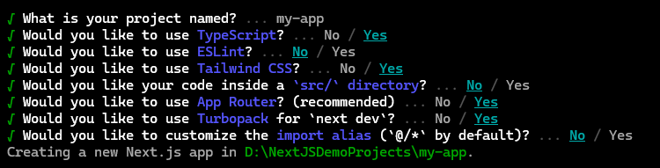
Creating Next.js application
System requirement:
Node.js 18.18 or later.
macOS, Windows (including WSL) and linux are supported.
Installation Types:
Automatic installation
Manual installation (we are not going to cover this)
Automatic Installation:
In order to install Next.js application we need to fire following command,
In this automatic installation process you will prompt following questions,
npx create-next-app@latest

Slide 7
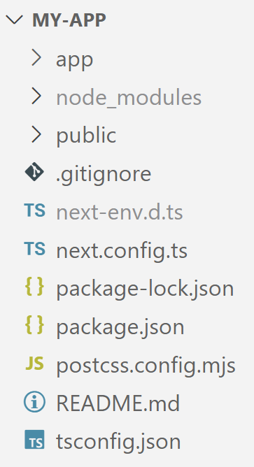
Project Structure
Top level folders
app: contains App Router
public: contains static assets to be served
node_modules: contains dependencies
src (optional, generated if selected yes in installation process): application source folder
Top level files
next.config.js: configuration file for Next.js
tsconfig.json: configuration fole for TypeScript
next-env.d.ts: TypeScript declaration file (do not change)
package.json: manifest file that describe project

Slide 8
Next.js compiler
The Next.js Compiler, written in Rust using SWC (Speedy Web Compiler), allows Next.js to transform and minify your JavaScript code for production. This replaces Babel for individual files and Terser for minifying output bundles.
Compilation using the Next.js Compiler is 17x faster than Babel and enabled by default since Next.js version 12. If you have an existing Babel configuration or are using unsupported features, your application will opt-out of the Next.js Compiler and continue using Babel.
SWC (Speedy Web Compiler):
SWC is an extensible Rust-based platform for the next generation of fast developer tools.
SWC can be used for compilation, minification, bundling, and more – and is designed to be extended.
Why they chose SWC?
Extensibility: SWC can be used as a Crate inside Next.js, without having to fork the library or workaround design constraints.
Performance: We were able to achieve ~3x faster Fast Refresh and ~5x faster builds in Next.js by switching to SWC, with more room for optimization still in progress.
WebAssembly: Rust's support for WASM is essential for supporting all possible platforms and taking Next.js development everywhere.
Community: The Rust community and ecosystem are amazing and still growing.

Slide 9
Fast Refresh
Fast refresh is a React feature integrated into Next.js that allows you live reload the browser page while maintaining temporary client-side state when you save changes to a file. It's enabled by default in all Next.js applications on 9.4 or newer. With Fast Refresh enabled, most edits should be visible within a second.
This is how Fast Refresh works,
If you edit a file that only exports React component(s), Fast Refresh will update the code only for that file, and re-render your component. You can edit anything in that file, including styles, rendering logic, event handlers, or effects.
If you edit a file with exports that aren't React components, Fast Refresh will re-run both that file, and the other files importing it. So if both Button.js and Modal.js import theme.js, editing theme.js will update both components.
Finally, if you edit a file that's imported by files outside of the React tree, Fast Refresh will fall back to doing a full reload. You might have a file which renders a React component but also exports a value that is imported by a non-React component. For example, maybe your component also exports a constant, and a non-React utility file imports it. In that case, consider migrating the constant to a separate file and importing it into both files. This will re-enable Fast Refresh to work. Other cases can usually be solved in a similar way.

Slide 10
Routing Fundamentals Next.js uses file-system based routing, meaning you can use folders and files to define routes.
Section - 02

Slide 11
Pages
A page is UI (component) that is rendered on a specific route.
Next.js uses a file-based routing system that automatically maps files in the pages directory to application routes, supporting static, dynamic, and nested routes for seamless web development.
To create a page, add a page file inside the app directory and default export a React component. For example, to create an index page (/) we need to create page.js or page.ts or page.jsx or page.tsx file in app folder with following code in it.
To boot the server you need to fire following command from the project folder
This command will start web server on port number 3000 (default), and you can see the page in the browser using the url http://localhost:3000
app/page.tsx
export default function Home() {
return (
<h1>Hello world from Next.js</h1>
);
}
npm run dev

Slide 12
Layout
A layout is UI that is shared between multiple pages. On navigation, layouts preserve state, remain interactive, and do not re-render.
You can define a layout by default exporting a React component from a layout file. The component should accept a children prop which can be a page or another layout.
For example, to create a layout that accepts your index page as child, add a layout file inside the app directory.
The layout above is called a root layout because it's defined at the root of the app directory. The root layout is required and must contain html and body tags.
app/layout.tsx
export default function DashboardLayout({
children,
}: {
children: React.ReactNode
}) {
return (
<html lang="en">
<body>
{/* Layout UI */}
{/* Place children where you want to render a
page or nested layout */}
<main>{children}</main>
</body>
</html>
)
}

Slide 13
Nested Route
A nested route is a route composed of multiple URL segments.
For example, the /blog/[slug] route is composed of three segments:
/ (Root Segment)
blog (Segment)
[slug] (Leaf Segment)
In Next.js:
Folders are used to define the route segments that map to URL segments.
Files (like page and layout) are used to create UI that is shown for a segment.
To create nested routes, you can nest folders inside each other.
For example, to add a route for /blog, create a folder called blog in the app directory. Then, to make /blog publicly accessible, add a page file:
You can continue nesting folders and create page.tsx file in each folder to create nested routes.
app/blog/page.tsx
export default function Blog() {
return (
<h1>Hello world from Blog Page</h1>
);
}

Slide 14
Nested Layout
By default, layouts in the folder hierarchy are also nested, which means they wrap child layouts via their children prop. You can nest layouts by adding layout inside specific route segments (folders).
For example, to create a layout for the /blog route, add a new layout file inside the blog folder.
If you were to combine the two layouts above, the root layout (app/layout.js) would wrap the blog layout (app/blog/layout.js), which would wrap the blog (app/blog/page.js)
app/blog/layout.tsx
export default function BlogLayout({
children,
}: {
children: React.ReactNode
}) {
return <section>{children}</section>
}

Slide 15
Linking and Navigation
There are four ways to navigate between routes in Next.js:
Using the <Link> Component
Using the useRouter hook (Client Components)
Using the redirect function (Server Components)
Using the native History API
In the next few slides, we will go through how to use each of these options, and dive deeper into how navigation works.

Slide 16
1. <Link> component
<Link> is a built-in component that extends the HTML <a> tag to provide prefetching and client-side navigation between routes. It is the primary and recommended way to navigate between routes in Next.js.
You can use it by importing it from next/link, and passing a href prop to the component:
The following props can be passed to the <Link> component:
app/page.tsx
import Link from 'next/link'
export default function Page() {
return <Link href="/dashboard">Dashboard</Link>
}
Prop | Example | Type | Required
href | href="/dashboard" | String or Object | Yes
replace | replace={false} | Boolean | -
scroll | scroll={false} | Boolean | -
prefetch | prefetch={false} | Boolean or null | -

Slide 17
Props of a Link component
href: The path or URL to navigate to.
replace: Defaults to false. When true, next/link will replace the current history state instead of adding a new URL into the browser's history stack.
app/page.tsx
// Navigate to /about?name=test
export default function Page() {
return (
<Link
href={{
pathname: '/about',
query: { name: 'test' },
}}
>
About
</Link>
)
}
app/page.tsx
import Link from 'next/link'
export default function Page() {
return <Link href="/dashboard" replace> Dashboard </Link>
}

Slide 18
Props of a Link component (Cont.)
scroll:
Defaults to true. The default scrolling behaviour of <Link> in Next.js is to maintain scroll position, similar to how browsers handle back and forwards navigation.
When you navigate to a new Page, scroll position will stay the same as long as the Page is visible in the viewport. However, if the Page is not visible in the viewport, Next.js will scroll to the top of the first Page element.
app/page.tsx
import Link from 'next/link'
export default function Page() {
return <Link href="/dashboard" scroll={false}> Dashboard </Link>
}

Slide 19
Props of a Link component (Cont.)
prefetch:
Prefetching happens when a <Link /> component enters the user's viewport (initially or through scroll). Next.js prefetches and loads the linked route (denoted by the href) and its data in the background to improve the performance of client-side navigations. If the prefetched data has expired by the time the user hovers over a <Link />, Next.js will attempt to prefetch it again. Prefetching is only enabled in production.
The following values can be passed to the prefetch prop:
null (default): Prefetch behaviour depends on whether the route is static or dynamic. For static routes, the full route will be prefetched (including all its data). For dynamic routes, the partial route down to the nearest segment with a loading.js boundary will be prefetched.
true: The full route will be prefetched for both static and dynamic routes.
false: Prefetching will never happen both on entering the viewport and on hover.
app/page.tsx
import Link from 'next/link'
export default function Page() {
return <Link href="/dashboard" prefetch={false}> Dashboard </Link>
}

Slide 20
2. useRouter() hook
The useRouter hook allows you to programmatically change routes from Client Components.
Recommendation: Use the <Link> component to navigate between routes unless you have a specific requirement for using useRouter.
app/page.tsx
'use client'
import { useRouter } from 'next/navigation'
export default function Page() {
const router = useRouter()
return (
<button
type="button"
onClick={() => router.push('/dashboard')}>
Dashboard
</button>
)
}

Slide 21
3. “redirect” function
The redirect function allows you to redirect the user to another URL. redirect can be used in Server Components, Route Handlers, and Server Actions.
For Server Components, use the redirect function instead of useRouter() hook.
app/page.tsx
Some important points about “redirect” function
redirect returns a 307 (Temporary Redirect) status code by default.
When used in a Server Action, it returns a 303 (See Other), which is commonly used for redirecting to a success page as a result of a POST request.
redirect internally throws an error so it should be called outside of try/catch blocks.
redirect can be called in Client Components during the rendering process but not in event handlers. You can use the useRouter hook instead.
redirect also accepts absolute URLs and can be used to redirect to external links.
import { redirect } from 'next/navigation'
export default function Home() {
// ...
const team = fetchTeam()
if (!team) {
redirect('/join')
}
// ...
}

Slide 22
Route Group
In the app directory, nested folders are normally mapped to URL paths. However, you can mark a folder as a Route Group to prevent the folder from being included in the route's URL path.
This allows you to organize your route segments and project files into logical groups without affecting the URL path structure.
Route groups are useful for:
Organizing routes into groups e.g. by site section, intent, or team.
Enabling nested layouts in the same route segment level:
Creating multiple nested layouts in the same segment, including multiple root layouts
Adding a layout to a subset of routes in a common segment
Adding a loading skeleton to specific route in a common segment
A route group can be created by wrapping a folder's name in parenthesis: (folderName)

Slide 23
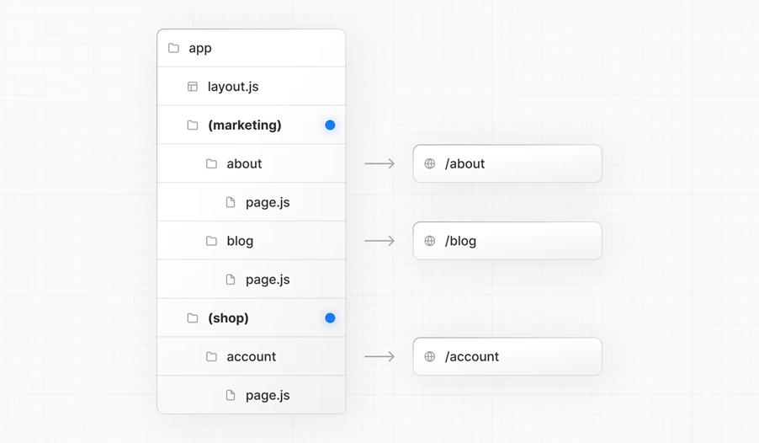
Use cases of Route Group
Organize routes without affecting the URL path: To organize routes without affecting the URL, create a group to keep related routes together. The folders in parenthesis will be omitted from the URL (e.g. (marketing) or (shop) ).

Slide 24
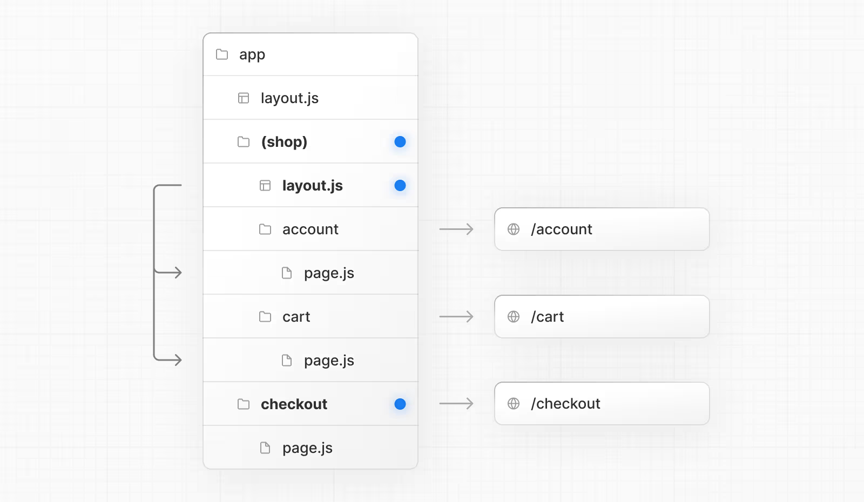
Use cases of Route Group (Cont.)
Opting specific segments into a layout: To opt specific routes into a layout, create a new route group (e.g. (shop)) and move the routes that share the same layout into the group (e.g. account and cart). The routes outside of the group will not share the layout (e.g. checkout).

Slide 25

Use cases of Route Group (Cont.)
Opting for loading skeletons on a specific route: To apply a loading skeleton via a loading.js file to a specific route, create a new route group (e.g., /(overview)) and then move your loading.tsx inside that route group.

Slide 26
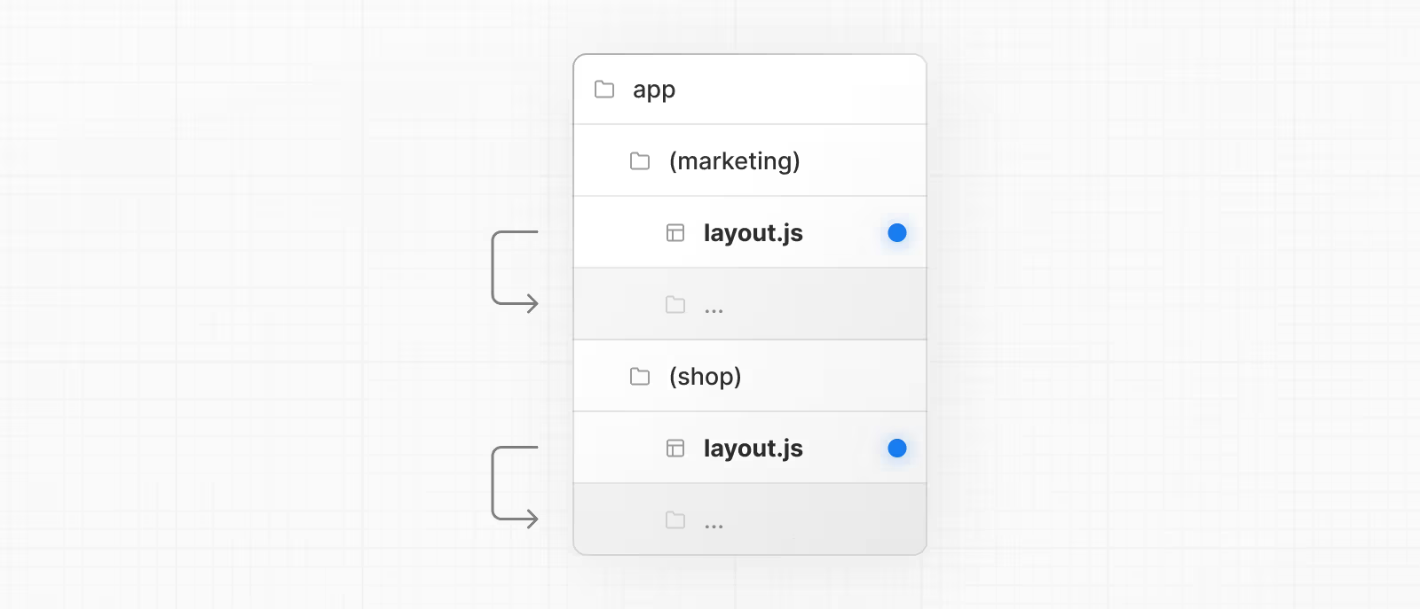
Use cases of Route Group (Cont.)
Creating multiple root layouts:
To create multiple root layouts, remove the top-level layout.js file, and add a layout.js file inside each route group. This is useful for partitioning an application into sections that have a completely different UI or experience. The <html> and <body> tags need to be added to each root layout.
In the example below, both (marketing) and (shop) have their own root layout.

Slide 27
Important Points about Route Group
The naming of route groups has no special significance other than for organization. They do not affect the URL path.
Routes that include a route group should not resolve to the same URL path as other routes. For example, since route groups don't affect URL structure, (marketing)/about/page.js and (shop)/about/page.js would both resolve to /about and cause an error.
If you use multiple root layouts without a top-level layout.js file, your home page.js file should be defined in one of the route groups, For example: app/(marketing)/page.js.
Navigating across multiple root layouts will cause a full page load (as opposed to a client-side navigation). For example, navigating from /cart that uses app/(shop)/layout.js to /blog that uses app/(marketing)/layout.js will cause a full page load. This only applies to multiple root layouts.

Slide 28
Dynamic Routes (parameterized routes)
When you don't know the exact segment names ahead of time and want to create routes from dynamic data, you can use Dynamic Segments that are filled in at request time or prerendered at build time.
A Dynamic Segment can be created by wrapping a folder's name in square brackets: [folderName]. For example, [id] or [slug].
Dynamic Segments are passed as the params prop to layout, page, route, and generateMetadata functions.
For example, a blog could include the following route app/blog/[slug]/page.js where [slug] is the Dynamic Segment for blog posts.

Slide 29
Example of Dynamic Route
Important Points about Dynamic Routes
Since the params prop is a promise. You must use async/await or React's use function to access the values.
In version 14 and earlier, params was a synchronous prop. To help with backwards compatibility, you can still access it synchronously in Next.js 15, but this behaviour will be deprecated in the future.
app/page.tsx
export default async function Page({
params,
}: {
params: Promise<{ slug: string }>
}) {
const { slug } = await params
return <div>My Post: {slug}</div>
}
Example URL | Params
/blog/arjun | { slug : 'arjun' }
/blog/123 | { slug : '123' }

Slide 30
Dynamic Routes (Catch-all Segments)
Dynamic Segments can be extended to catch-all subsequent segments by adding an ellipsis inside the brackets [...folderName].
For example, app/shop/[...slug]/page.js will match /shop/clothes, but also /shop/clothes/tops, /shop/clothes/tops/t-shirts, and so on.
Route | Example URL | Params
app/shop/[...slug]/page.js | /shop/a | { slug: ['a'] }
app/shop/[...slug]/page.js | /shop/a/b | { slug: ['a', 'b'] }
app/shop/[...slug]/page.js | /shop/a/b/c | { slug: ['a', 'b', 'c'] }

Slide 31
Dynamic Routes (Optional Catch-all Segments)
Catch-all Segments can be made optional by including the parameter in double square brackets: [[...folderName]].
For example, app/shop/[[...slug]]/page.js will also match /shop, in addition to /shop/clothes, /shop/clothes/tops, /shop/clothes/tops/t-shirts.
The difference between catch-all and optional catch-all segments is that with optional, the route without the parameter is also matched (/shop in the example above).
Route | Example URL | Params
app/shop/[[...slug]]/page.js | /shop | { slug: undefined }
app/shop/[[...slug]]/page.js | /shop/a | { slug: ['a'] }
app/shop/[[...slug]]/page.js | /shop/a/b | { slug: ['a', 'b'] }
app/shop/[[...slug]]/page.js | /shop/a/b/c | { slug: ['a', 'b', 'c'] }

Slide 32
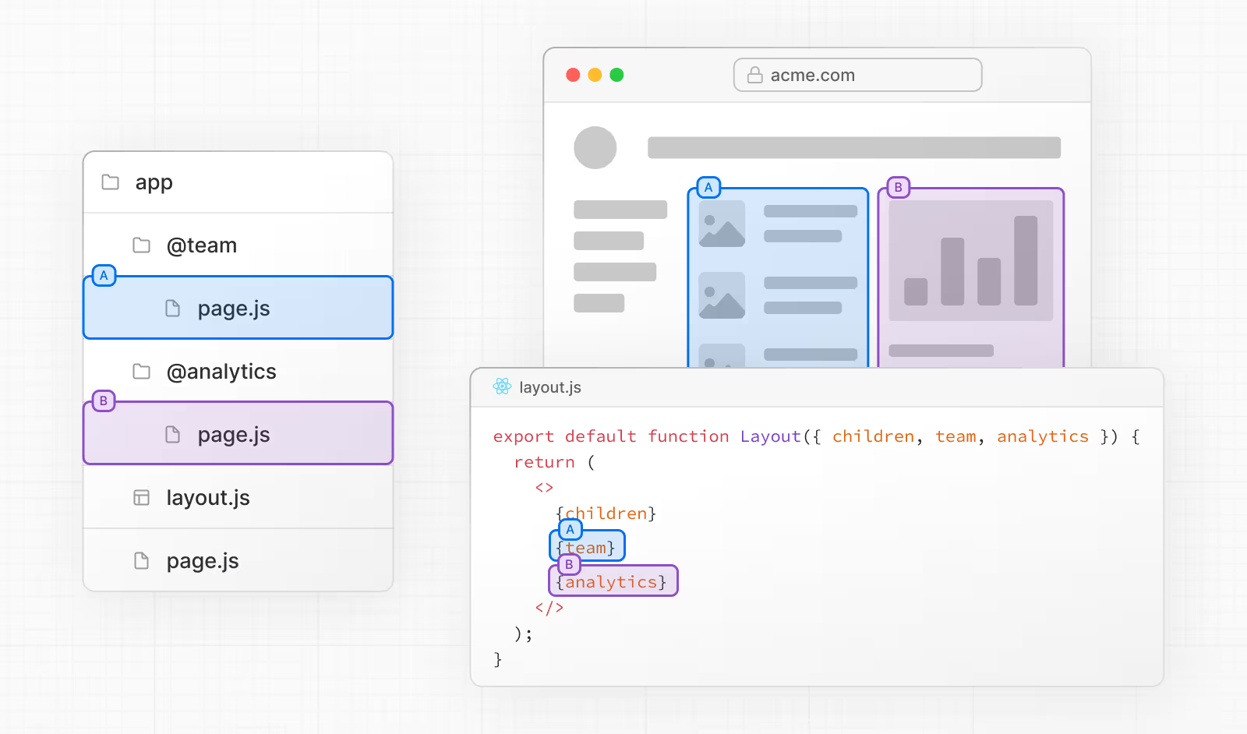
Parallel Routes
Parallel Routes allows you to simultaneously or conditionally render one or more pages within the same layout. They are useful for highly dynamic sections of an app, such as dashboards and feeds on social sites.
For example, considering a dashboard, you can use parallel routes to simultaneously render the team and analytics pages:
Parallel routes are created using named slots. Slots are defined with the @folder convention. For example, the file structure above defines two slots: @analytics and @team

Slide 33
Parallel Routes (Cont.)
Slots are passed as props to the shared parent layout. For the example above, the component in app/layout.js now accepts the @analytics and @team slots props, and can render them in parallel alongside the children prop:
However, slots are not route segments and do not affect the URL structure. For example, for /@analytics/views, the URL will be /views since @analytics is a slot.
Slots are combined with the regular Page component to form the final page associated with the route segment. Because of this, you cannot have separate static and dynamic slots at the same route segment level. If one slot is dynamic, all slots at that level must be dynamic.
app/layout.tsx
export default function Layout({
children,
team,
analytics,
}: {
children: React.ReactNode
analytics: React.ReactNode
team: React.ReactNode
}) {
return (
<>
{children}
{team}
{analytics}
</>
)
}

Slide 34
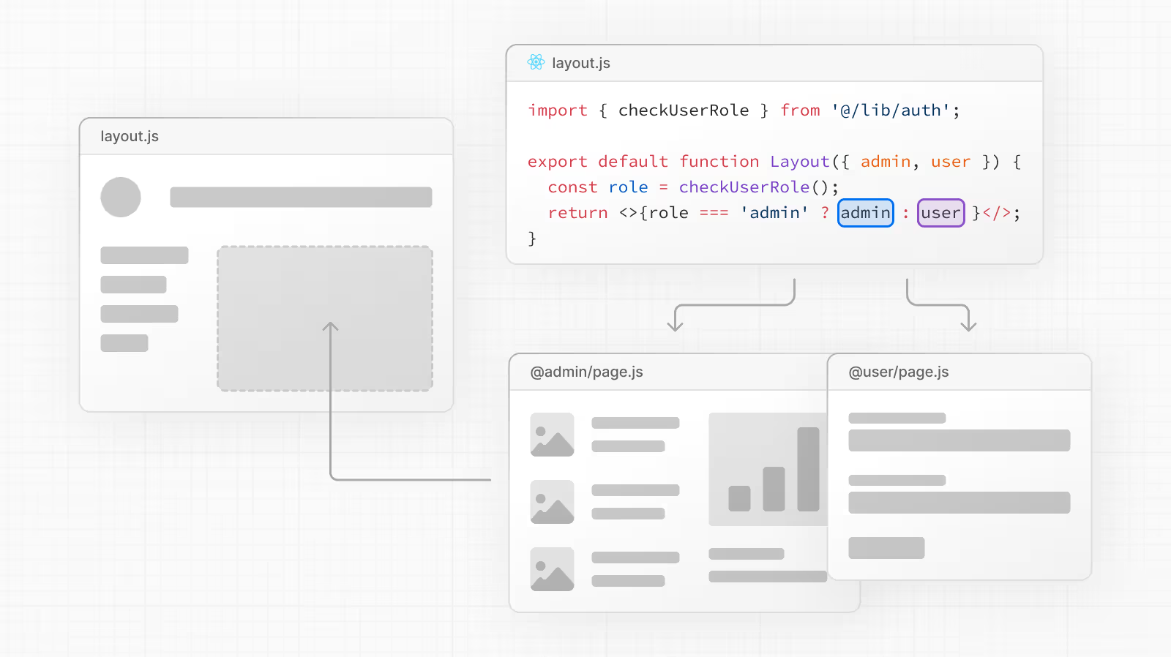
Parallel Routes (use cases)
There are many use cases of parallel routes, some of which are conditional routes, tab group, modals, loading error UI etc..
Here is an example of using parallel routes for conditional rendering.
You can use Parallel Routes to conditionally render routes based on certain conditions, such as user role. For example, to render a different dashboard page for the /admin or /user roles:
app/layout.tsx
import { checkUserRole } from '@/lib/auth'
export default function Layout({
user,
admin,
}: {
user: React.ReactNode
admin: React.ReactNode
}) {
const role = checkUserRole()
return role === 'admin' ? admin : user
}

Slide 35
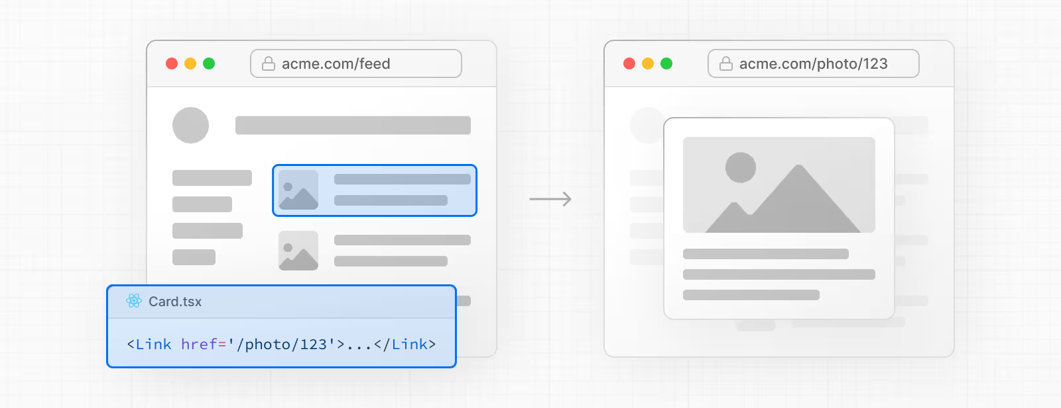
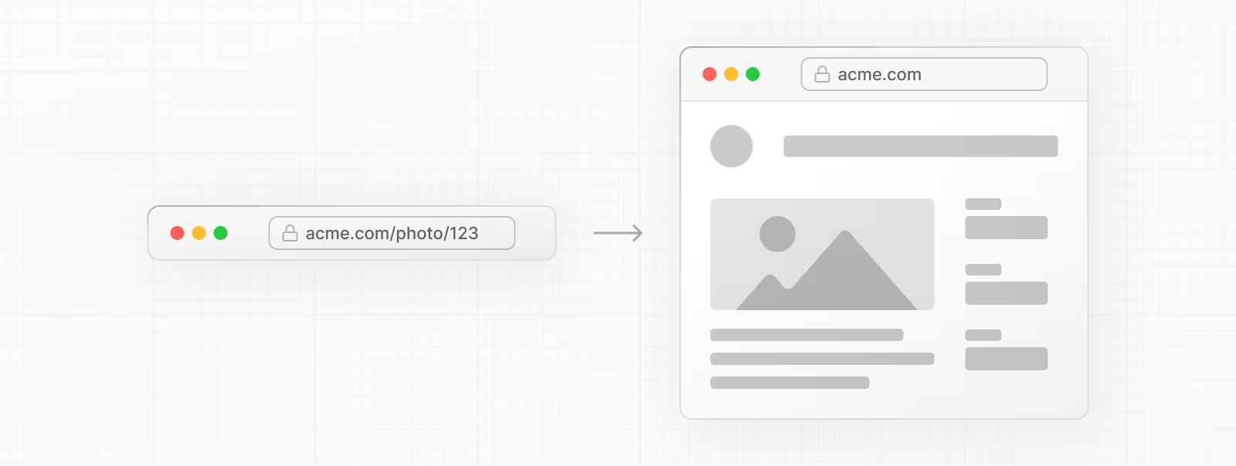
Intercepting Routes
Intercepting routes allows you to load a route from another part of your application within the current layout. This routing paradigm can be useful when you want to display the content of a route without the user switching to a different context.
For example, when clicking on a photo in a feed, you can display the photo in a modal, overlaying the feed. In this case, Next.js intercepts the /photo/123 route, masks the URL, and overlays it over /feed.
However, when navigating to the photo by clicking a shareable URL or by refreshing the page, the entire photo page should render instead of the modal. No route interception should occur.

Slide 36
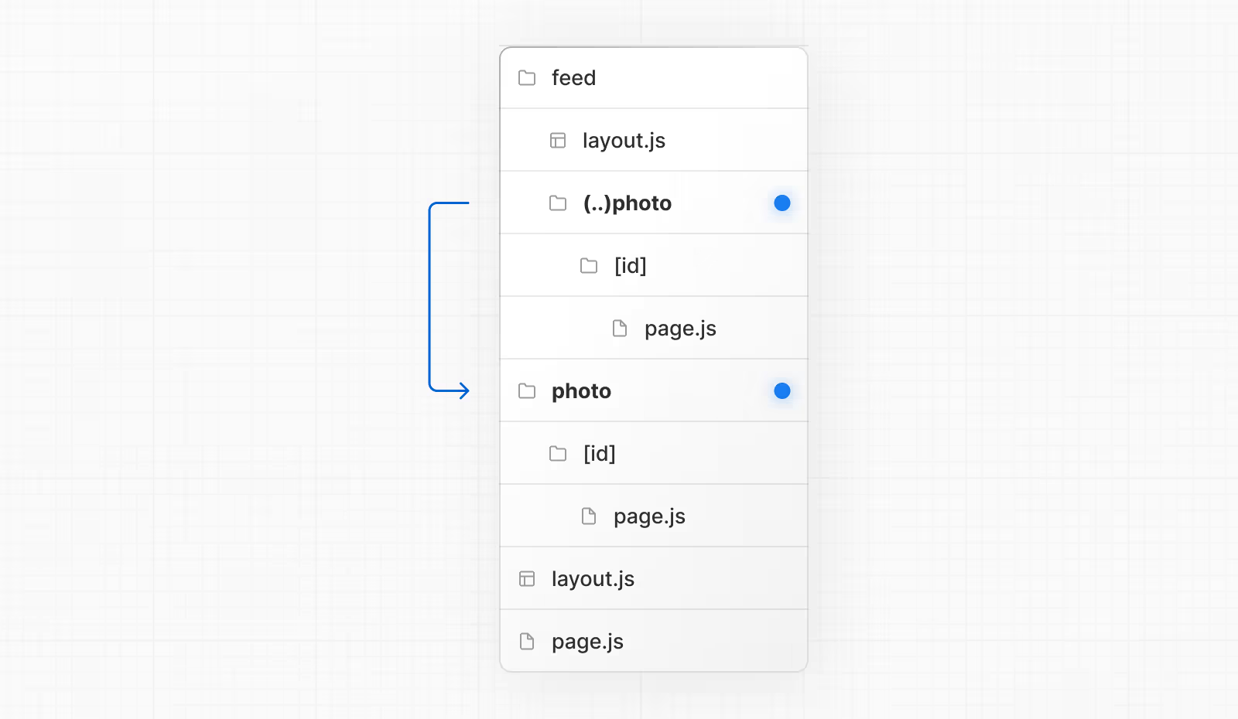
Intercepting Routes (Cont.)
Intercepting routes can be defined with the (..) convention, which is similar to relative path convention ../ but for segments.
You can use:
(.) to match segments on the same level
(..) to match segments one level above
(..)(..) to match segments two levels above
(...) to match segments from the root app directory
For example, you can intercept the photo segment from within the feed segment by creating a (..)photo directory.

Slide 37
File Conventions
In Next.js, file naming conventions play a big role, especially when it comes to routing and structuring your application
default.js
During soft navigation, Next.js keeps track of the active state (subpage) for each slot. However, for hard navigations (full-page load), Next.js cannot recover the active state. In this case, a default.js file can be rendered for subpages that don't match the current URL.
error.js
An error file allows you to handle unexpected runtime errors and display fallback UI.
layout.js
The layout file is used to define a layout in your Next.js application.
loading.js
A loading file can create instant loading states built on Suspense.
By default, this file is a Server Component - but can also be used as a Client Component through the "use client" directive.
not-found.js
The not-found file is used to render UI when the notFound function is thrown within a route segment. Along with serving a custom UI, Next.js will return a 200 HTTP status code for streamed responses, and 404 for non-streamed responses.

Slide 38
File Conventions (Cont.)
middleware.js
The middleware.js|ts file is used to write Middleware and run code on the server before a request is completed. Then, based on the incoming request, you can modify the response by rewriting, redirecting, modifying the request or response headers, or responding directly.
Middleware executes before routes are rendered. It's particularly useful for implementing custom server-side logic like authentication, logging, or handling redirects.
page.js
We can create component with page.js file, we have already discussed this in great detail.
route.js
Route Handlers allow you to create custom request handlers for a given route using the Web Request and Response APIs.
template.js
A template file is similar to a layout in that it wraps a layout or page. Unlike layouts that persist across routes and maintain state, templates are given a unique key, meaning children Client Components reset their state on navigation.
unauthorized.js
The unauthorized file is used to render UI when the unauthorized function is invoked during authentication. Along with allowing you to customize the UI, Next.js will return a 401 status code.
Note: as of April 2025 this feature is experimental and subject to change, it's not recommended for production.

Slide 39
Route Handlers
Route Handlers allow you to create custom request handlers for a given route using the Web Request and Response APIs.
Route Handlers are defined in a route.js (or .jsx, .ts, .tsx) file.
Route Handlers can be nested anywhere inside the app directory, similar to page.js and layout.js.
There cannot be a route.js file at the same route
segment level as page.js.
We can then access the route using /demo URL.
The following HTTP methods are supported: GET, POST, PUT, PATCH, DELETE, HEAD, and OPTIONS.
If an unsupported method is called, Next.js will return a 405 Method Not Allowed response.
In addition to supporting the native Request and Response APIs, Next.js extends them with NextRequest and NextResponse to provide convenient helpers for advanced use cases.
app/demo/route.tsx
export async function GET(request: Request) {
return new Response("Created with Route Handler");
}

Slide 40
Middlewares
Middleware allows you to run code before a request is completed. Then, based on the incoming request, you can modify the response by rewriting, redirecting, modifying the request or response headers, or responding directly.
Middleware runs before cached content and routes are matched.
Integrating Middleware into your application can lead to significant improvements in performance, security, and user experience.
Some common scenarios where Middleware is particularly effective include:
Authentication and Authorization: Ensure user identity and check session cookies before granting access to specific pages or API routes.
Server-Side Redirects: Redirect users at the server level based on certain conditions (e.g., locale, user role).
Path Rewriting: Support A/B testing, feature rollouts, or legacy paths by dynamically rewriting paths to API routes or pages based on request properties.
Bot Detection: Protect your resources by detecting and blocking bot traffic.
Logging and Analytics: Capture and analyze request data for insights before processing by the page or API.
Feature Flagging: Enable or disable features dynamically for seamless feature rollouts or testing.

Slide 41
Middlewares (Cont.)
Recognizing situations where middleware may not be the optimal approach is just as crucial. Here are some scenarios to be mindful of:
Complex Data Fetching and Manipulation: Middleware is not designed for direct data fetching or manipulation; this should be done within Route Handlers or server-side utilities instead.
Heavy Computational Tasks: Middleware should be lightweight and respond quickly or it can cause delays in page load. Heavy computational tasks or long-running processes should be done within dedicated Route Handlers.
Extensive Session Management: While Middleware can manage basic session tasks, extensive session management should be managed by dedicated authentication services or within Route Handlers.
Direct Database Operations: Performing direct database operations within Middleware is not recommended. Database interactions should be done within Route Handlers or server-side utilities.
We need to create a middleware.ts (or .js) file in the root of your project to define Middleware.
While only one middleware.ts file is supported per project, you can still organize your middleware logic modularly.

Slide 42
Middlewares (Cont.)
Break out middleware functionalities into separate .ts or .js files and import them into your main middleware.ts file.
This allows for cleaner management of route-specific middleware, aggregated in the middleware.ts for centralized control.
By enforcing a single middleware file, it simplifies configuration, prevents potential conflicts, and optimizes performance by avoiding multiple middleware layers.
middleware.ts
import { NextResponse } from 'next/server'
import type { NextRequest } from 'next/server'
export function middleware(request: NextRequest) {
return NextResponse.redirect(new URL('/home', request.url))
}
export const config = {
matcher: '/about/:path*',
}

Slide 43
Middlewares (Matching Paths)
Middleware will be invoked for every route in your project. Given this, it's crucial to use matchers to precisely target or exclude specific routes.
The following is the execution order:
headers from next.config.js
redirects from next.config.js
Middleware (rewrites, redirects, etc.)
beforeFiles (rewrites) from next.config.js
Filesystem routes (public/, _next/static/, pages/, app/, etc.)
afterFiles (rewrites) from next.config.js
Dynamic Routes (/blog/[slug])
fallback (rewrites) from next.config.js

Slide 44
Middlewares (Cont.)
There are two ways to define which paths Middleware will run on:
Custom matcher config:
matcher allows you to filter Middleware to run on specific paths, we can match a single path or multiple paths with an array syntax:
The matcher config allows full regex so matching like negative lookaheads or character matching is also supported.
Conditional statements
Conditional statements in Next.js middleware allow you to execute specific logic based on the incoming request.
This can be useful for tasks such as authentication, authorization, redirects, rewrites, and feature flags.
middleware.ts
import { NextResponse } from 'next/server'
import type { NextRequest } from 'next/server'
export function middleware(request: NextRequest) {
if (request.nextUrl.pathname.startsWith('/about')) {
return NextResponse.rewrite(
new URL('/about-2', request.url)
)
}
if (request.nextUrl.pathname.startsWith('/dashboard')) {
return NextResponse.rewrite(
new URL('/dashboard/user', request.url)
)
}
}
middleware.ts
export const config = {
matcher: ['/about/:path*', '/dashboard/:path*'],
}

Slide 45
Rendering Fundamentals Rendering converts the code you write into user interfaces.
Section - 03

Slide 46
Rendering
Rendering converts the code you write into user interfaces.
React and Next.js allow you to create hybrid web applications where parts of your code can be rendered on the server or the client.
This section will help you understand the differences between these rendering environments, strategies, and runtimes.
Rendering Fundamentals:
To start, it's helpful to be familiar with three foundational web concepts:
The Environments your application code can be executed in: the server and the client.
The Request-Response Lifecycle that's initiated when a user visits or interacts with your application.
The Network Boundary that separates server and client code.

Slide 47
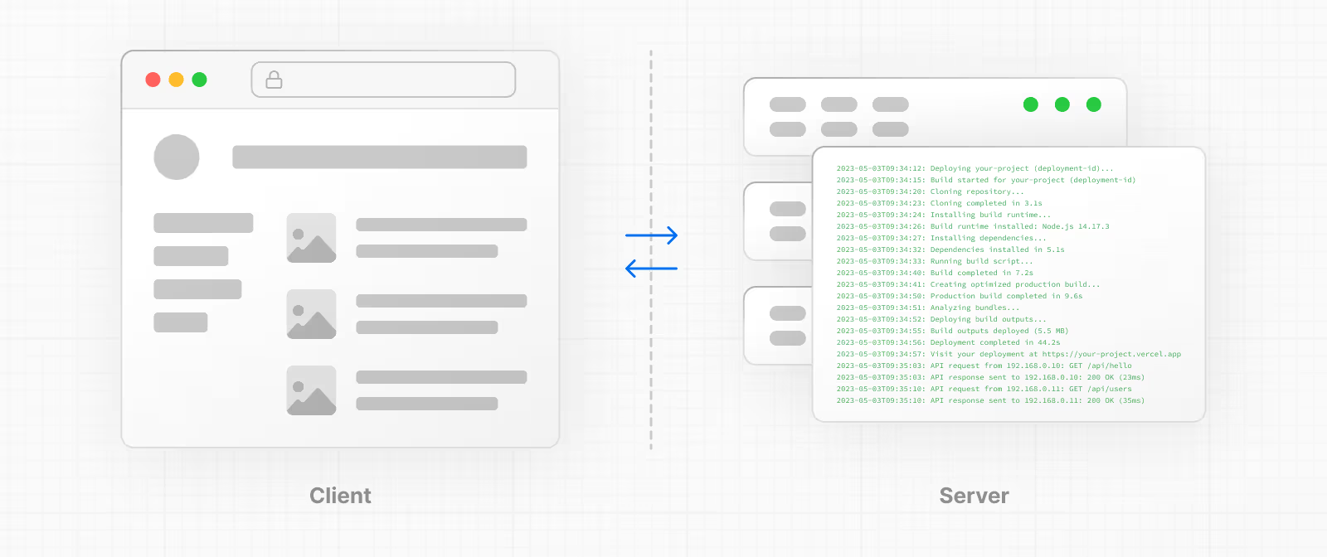
Rendering Environments
There are two environments where web applications can be rendered: the client and the server.

Slide 48
Rendering Environments (Cont.)
The client refers to the browser on a user's device that sends a request to a server for your application code. It then turns the response from the server into a user interface.
The server refers to the computer in a data center that stores your application code, receives requests from a client, and sends back an appropriate response.
Historically, developers had to use different languages (e.g. JavaScript, PHP, JSP etc…) and frameworks when writing code for the server and the client.
With React, developers can use the same language (JavaScript), and the same framework (e.g. Next.js or your framework of choice). This flexibility allows you to seamlessly write code for both environments without context switching.
However, each environment has its own set of capabilities and constraints. Therefore, the code you write for the server and the client is not always the same. There are certain operations (e.g. data fetching or managing user state) that are better suited for one environment over the other.
Understanding these differences is key to effectively using React and Next.js.

Slide 49
Request-Response Lifecycle
Broadly speaking, all websites follow the same Request-Response Lifecycle:
User Action: The user interacts with a web application. This could be clicking a link, submitting a form, or typing a URL directly into the browser's address bar.
HTTP Request: The client sends an HTTP request to the server that contains necessary information about what resources are being requested, what method is being used (e.g. GET, POST), and additional data if necessary.
Server: The server processes the request and responds with the appropriate resources. This process may take a couple of steps like routing, fetching data, etc.
HTTP Response: After processing the request, the server sends an HTTP response back to the client. This response contains a status code (which tells the client whether the request was successful or not) and requested resources (e.g. HTML, CSS, JavaScript, static assets, etc).
Client: The client parses the resources to render the user interface.
User Action: Once the user interface is rendered, the user can interact with it, and the whole process starts again.
A major part of building a hybrid web application is deciding how to split the work in the lifecycle, and where to place the Network Boundary.

Slide 50
Network Boundary
In web development, the Network Boundary is a conceptual line that separates the different environments. For example, the client and the server, or the server and the data store.
In React, you choose where to place the client-server network boundary wherever it makes the most sense.
Behind the scenes, the work is split into two parts: the client module graph and the server module graph. The server module graph contains all the components that are rendered on the server, and the client module graph contains all components that are rendered on the client.
It may be helpful to think about module graphs as a visual representation of how files in your application depend on each other.
You can use the React "use client" convention to define the boundary. There's also a "use server" convention, which tells React to do some computational work on the server.

Slide 51
Server Components
React Server Components allow you to write UI that can be rendered and optionally cached on the server.
By default, Next.js uses Server Components. This allows you to automatically implement server rendering with no additional configuration.
Note:
It is optional to specify the ‘use server’, as it is default behaviour of next
But if you specify the ‘use server’ you have to make the function async
app/page.tsx
'use server'
export default async function Home() {
return (
<h1>Hello world from Next.js using server component</h1>
);
}

Slide 52
Server Component (Rendering strategies)
In Next.js, the rendering work is further split by route segments to enable streaming and partial rendering, and there are three different server rendering strategies:
Static Rendering
With Static Rendering, routes are rendered at build time, or in the background after data revalidation. The result is cached and can be pushed to a Content Delivery Network (CDN).
This optimization allows you to share the result of the rendering work between users and server requests.
Static rendering is useful when a route has data that is not personalized to the user and can be known at build time, such as a static blog post or a product page.
Dynamic Rendering
With Dynamic Rendering, routes are rendered for each user at request time.
Dynamic rendering is useful when a route has data that is personalized to the user or has information that can only be known at request time, such as cookies or the URL's search params.
Streaming
Streaming enables you to progressively render UI from the server. Work is split into chunks and streamed to the client as it becomes ready. This allows the user to see parts of the page immediately, before the entire content has finished rendering.
Streaming is built into the Next.js App Router by default. This helps improve both the initial page loading performance, as well as UI that depends on slower data fetches that would block rendering the whole route. For example, reviews on a product page.

Slide 53
Benefits of Server Rendering
Data Fetching: Server Components allow you to move data fetching to the server, closer to your data source. This can improve performance by reducing time it takes to fetch data needed for rendering, and the number of requests the client needs to make.
Security: Server Components allow you to keep sensitive data and logic on the server, such as tokens and API keys, without the risk of exposing them to the client.
Caching: By rendering on the server, the result can be cached and reused on subsequent requests and across users. This can improve performance and reduce cost by reducing the amount of rendering and data fetching done on each request.
Performance: Server Components give you additional tools to optimize performance from the baseline. For example, if you start with an app composed of entirely Client Components, moving non-interactive pieces of your UI to Server Components can reduce the amount of client-side JavaScript needed. This is beneficial for users with slower internet or less powerful devices, as the browser has less client-side JavaScript to download, parse, and execute.

Slide 54
Benefits of Server Rendering (Cont.)
Initial Page Load and First Contentful Paint (FCP): On the server, we can generate HTML to allow users to view the page immediately, without waiting for the client to download, parse and execute the JavaScript needed to render the page.
Search Engine Optimization and Social Network Shareability: The rendered HTML can be used by search engine bots to index your pages and social network bots to generate social card previews for your pages.
Streaming: Server Components allow you to split the rendering work into chunks and stream them to the client as they become ready. This allows the user to see parts of the page earlier without having to wait for the entire page to be rendered on the server.

Slide 55
How are Server Components rendered?
The rendering work is split into chunks, Each chunk is rendered in two steps:
React renders Server Components into a special data format called the React Server Component Payload (RSC Payload).
Next.js uses the RSC Payload and Client Component JavaScript instructions to render HTML on the server.
Then, on the client:
The HTML is used to immediately show a fast non-interactive preview of the route - this is for the initial page load only.
The React Server Components Payload is used to reconcile the Client and Server Component trees, and update the DOM.
The JavaScript instructions are used to hydrate Client Components and make the application interactive.
The RSC Payload is a compact binary representation of the rendered React Server Components tree. It's used by React on the client to update the browser's DOM.
The RSC Payload contains:
The rendered result of Server Components
Placeholders for where Client Components should be rendered and references to their JavaScript files
Any props passed from a Server Component to a Client Component

Slide 56
Client Components
Client Components allow you to write interactive UI that is prerendered on the server and can use client JavaScript to run in the browser.
To use Client Components, you can add the React "use client" directive at the top of a file, above your imports.
"use client" is used to declare a boundary between a Server and Client Component modules. This means that by defining a "use client" in a file, all other modules imported into it, including child components, are considered part of the client bundle.
app/page.tsx
'use client'
export default function Home() {
return (
<h1>Hello world from Next.js using client component </h1>
);
}

Slide 57
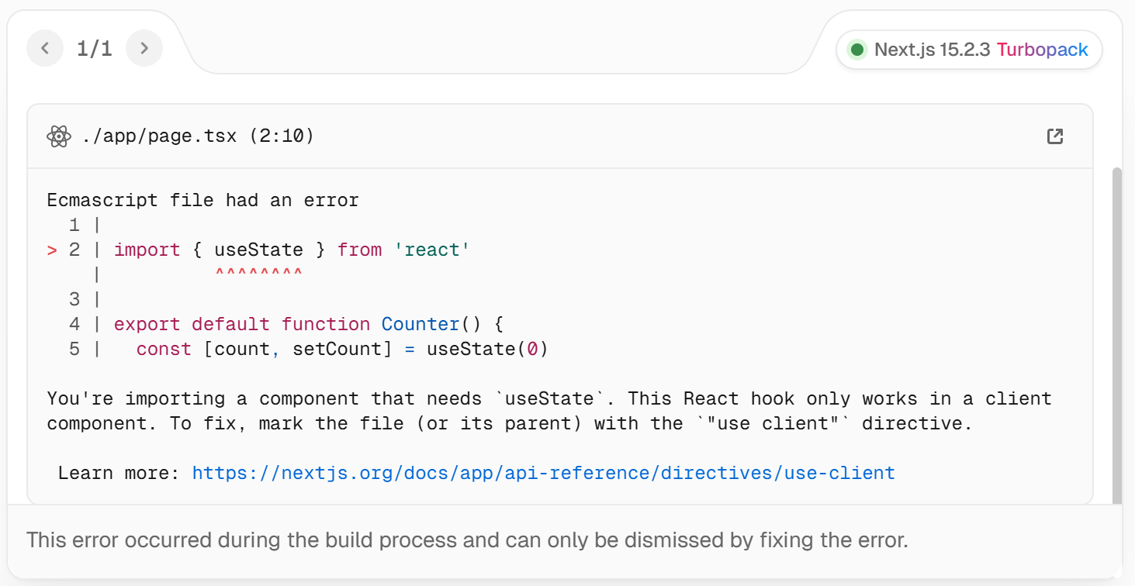
Use case of client component
For example, we want to use React’s useState hook which can only be used in client side rendering, if you try to use it on server component Next.js will throw an error.
Here, if you do not specify ‘use client’ directive, it will generate below error
app/page.tsx
'use client'
import { useState } from 'react'
export default function Counter() {
const [count, setCount] = useState(0)
return (
<div>
<p>You clicked {count} times</p>
<button onClick={() => setCount(count + 1)}>Click me</button>
</div>
)
}

Slide 58
How are Client Components Rendered?
In Next.js, Client Components are rendered differently depending on whether the request is part of a full page load (an initial visit to your application or a page reload triggered by a browser refresh) or a subsequent navigation.

Slide 59
Full Page Load: To optimize the initial page load, Next.js will use React's APIs to render a static HTML preview on the server for both Client and Server Components.
This means, when the user first visits your application, they will see the content of the page immediately, without having to wait for the client to download, parse, and execute the Client Component JavaScript.
On the server:
React renders Server Components into a special data format called the React Server Component Payload (RSC Payload), which includes references to Client Components.
Next.js uses the RSC Payload and Client Component JavaScript to render HTML for the route on the server.
Then, on the client:
The HTML is used to immediately show a fast non-interactive initial preview of the route.
The RSC Payload is used to reconcile the Client and Server Component trees, and update the DOM.
The JavaScript instructions are used to hydrate Client Components and make their UI interactive. (Hydration is the process of attaching event listeners to the DOM, to make the static HTML interactive.)
Subsequent Navigations: On subsequent navigations, Client Components are rendered entirely on the client, without the server-rendered HTML.
This means the Client Component JavaScript bundle is downloaded and parsed. Once the bundle is ready, React will use the RSC Payload to reconcile the Client and Server Component trees, and update the DOM.

Slide 60
Server and Client Composition Patterns
When building React applications, you will need to consider what parts of your application should be rendered on the server or the client.
When to use Server and Client Components?
What do you need to do? | Server Component | Client Component
Fetch data | YES | NO
Access backend resources (directly) | YES | NO
Keep sensitive information on the server (access tokens, API keys, etc) | YES | NO
Keep large dependencies on the server / Reduce client-side JavaScript | YES | NO
Add interactivity and event listeners (onClick(), onChange(), etc) | NO | YES
Use State and Lifecycle Effects (useState(), useReducer(), useEffect(), etc) | NO | YES
Use browser-only APIs | NO | YES
Use custom hooks that depend on state, effects, or browser-only APIs | NO | YES
Use React Class components | NO | YES

Slide 61
Runtimes
Next.js has two server runtimes you can use in your application:
The Node.js Runtime (default), which has access to all Node.js APIs and compatible packages from the ecosystem.
The Edge Runtime which contains a more limited set of APIs.
The Edge Runtime is the default runtime for Middleware. However, this can be changed to the Node.js runtime.

Slide 62
Advanced Web Technologies (AWT)
2301CS511
Prof. Arjun V. Bala
Computer Engineering Department
arjun.bala@darshan.ac.in
9624822202

